Slide 1
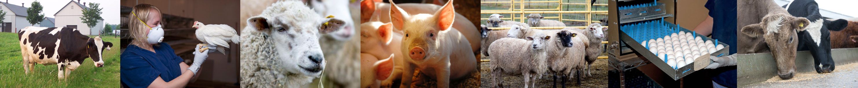
CCAC TRAINING MODULE ON:
GENETICALLY-ENGINEERED FARM ANIMALS
www.ccac.ca

Slide 2
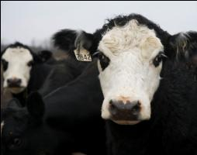
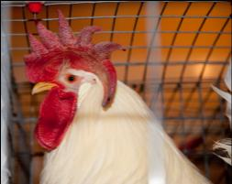
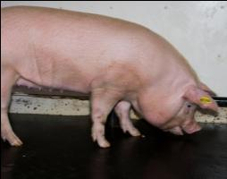
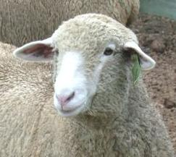
Relevance of this Training Module
This training module is relevant to all animal users working with genetically-engineered (GE) farm animals in research, teaching or testing.
This module covers the following GE farm animals:
  dairy and beef cattle
  sheep
  goats
  swine
  poultry
  horses
  farmed wildlife
Photo courtesy of Animal Resources Centre, University of Saskatchewan

Slide 3
Training Module Goals
Introduce the issues related to the impacts of genetic engineering on farm animals
Provide an appreciation for the special care requirements of GE farm animals
Provide investigators with references and resources for the ethical care and use of GE farm animals in science
Basic principles of farm animal welfare, fundamental needs, acquisition, routine handling and specialized procedures and termination of scientific use are covered in the
CCAC training module on: the ethical use and care of farm animals in science (2010)

Slide 4
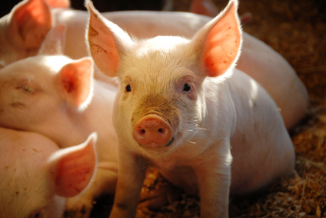
Training Module Outline
Overview of GE farm animals
Welfare issues
Regulations
Special considerations for potential alterations in care and nutrition

Slide 5
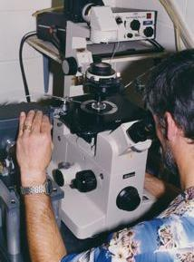
Definition of Genetically-Engineered Animals
GE animals have a random or targeted genetic change due to deliberate human technological intervention
Special considerations:
  unexpected welfare impacts
  ethical concerns
  risk to humans, environment, etc.
Photo courtesy of Dr. C. Forsberg
Pronuclear microinjection of embryos
See the CCAC guidelines on: genetically-engineered animals used in science (in prep.) for further information
5
Notes:
CAHNGES

Slide 6
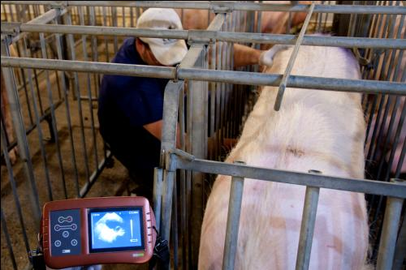
Factors Compromising the Welfare of Genetically-Engineered Farm Animals
Many potential issues may arise from genetic engineering; a few examples:
  high stillborn rates
  low short-term survival rates
  chronic long-term health issues
  developmental issues
  physiological abnormalities
Ultrasound scanning
Investigators should be aware that in addition to the intended effects of genetic engineering (e.g., deliberate production of diseases or gene function abnormalities), unintended effects are also likely

Slide 7
Regulations
Additional regulations for GE animals, as well as their progeny and products (e.g., “new substances”, “novel feeds”)
Environmental release and indirect human health impacts of “new substances” regulated by Environment Canada and Health Canada under the Canadian Environmental Protection Act, 1999 (CEPA)
Animal Feed Division of Canadian Food Inspection Agency requires safety assessment of “novel feeds”:
  livestock
  humans (worker/bystander exposure and consumption of products)
  environment

Slide 8
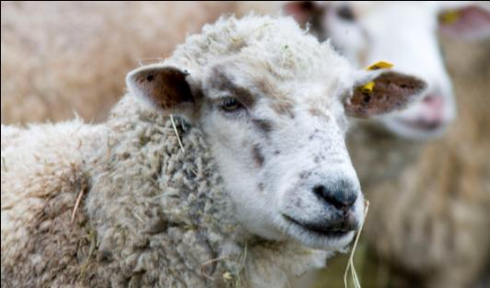
Identification & Tracking
Two separate forms of identification should be used for GE farm animals:
  permanent (e.g., microchip or tattoo)
  easy to identify and read (e.g., ear tag)
Records outlining the specifics of any genetic modification are necessary and:
  facilitate accurate follow-up care for health and welfare
  should be in accordance with regulatory agency and institutional requirements

Slide 9
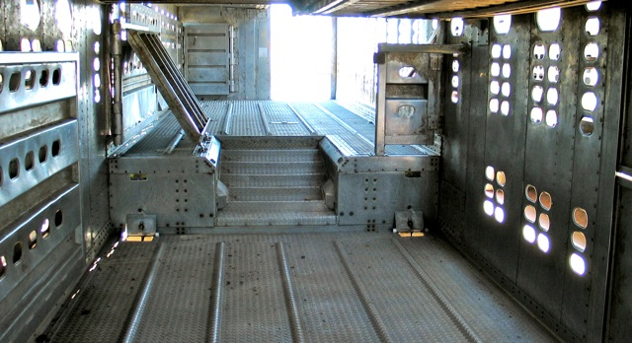
Transport
In addition to following species-specific guidelines, special consideration should be given to:
  biosecurity measures to prevent accidental release of genetically-engineered farm animals
    (e.g., transporting such animals separately from conventional farm animals)
  physiological impact of any genetic modifications
    (e.g., immunosuppression)
Photo courtesy of Agriculture and Agri-Food Canada

Slide 10
Confinement
At least two physical barriers should be used when confining GE farm animals
Maintain secure confinement
  limit access to authorized personnel only
  screen and log all visitors and vehicles
  adhere to any additional regulations

Slide 11
Care & Nutrition
Providing care tailored to the special needs of GE farm animals is important for both good animal welfare and for achieving scientific goals
  higher levels of monitoring required to identify unanticipated welfare concerns
Care and nutrition of GE farm animals will be heavily dependent on the:
  impact of specific genetic engineering methods
    (e.g., a transgene introduced may alter physiology)
  intended end use of animals or their products
11

Slide 12
Example of Potential Impact of Genetic Engineering: Nutrient Requirements Changes
Physiological pathways altered by genetic modification
Changes in digestion and absorption and utilization of nutrients
Potential deficiencies and toxicities
  e.g., animals kept indoors may require Vitamin D supplementation

Slide 13
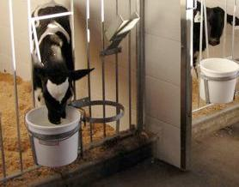
Example of Potential Impact of End Use:
Feeding Regimes
Considering the intended end use of GE farm animals will help dictate any necessary changes to feeding regime
  Alteration to conventional feeding practices (e.g., pesticide-free feed to animals producing pharmaceuticals in their milk)
  Offspring of animals used for producing products within their milk will need adapted feeding programs
Photo courtesy of UBC Animal Welfare Program

Slide 14
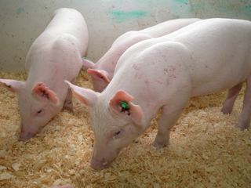
Ensuring Optimal Care
Systematic welfare assessment helps to identify potential effects of genetic engineering on physiological and behavioural states
Potential indicators of issues:
  changes in behaviour
  abnormal physical changes
Photo courtesy of Dr. C. Forsberg
Three grower hemizygous Enviropigs

Slide 15
Ensuring Optimal Care
Careful observation helps mitigate adverse welfare consequences by:
  revealing special needs and/or problems stemming from specific genetic engineering methods
  developing special care methods for animals in the same applications
  determining relevant endpoints
See the CCAC guidelines on: choosing an appropriate endpoint in experiments using animals for research, teaching and testing (1998) and the
CCAC training module on: pain, distress and endpoints (2010)
for further information regarding endpoints

Slide 16
Summary
Genetic engineering may have adverse effects on farm animals
Special consideration should be given to:
  regulations, identification and transportation
  meeting special care and nutrition needs of the GE farm animals based on the specific modifications made, as well as the intended end use of the animals
Paying attention to the special needs of GE farm animals will result in improved scientific outcomes
Investigators should strive to achieve their scientific goals in line with the best possible animal welfare standards
Notes:
Excellent slide and summary!

